Slide 1
Gradebook with Class Statistics
A C Programming Project
Submitted By: Harsh Vardhan
Guided By: Ms. Naina Devi
Course: Programming in C
Tool Used: VS Code

Slide 2
Agenda
Introduction
Problem Statement
Tools and Technologies
Project Description
Project Working
Features
Applications
Advantages
Future Scope
Conclusion

Slide 3
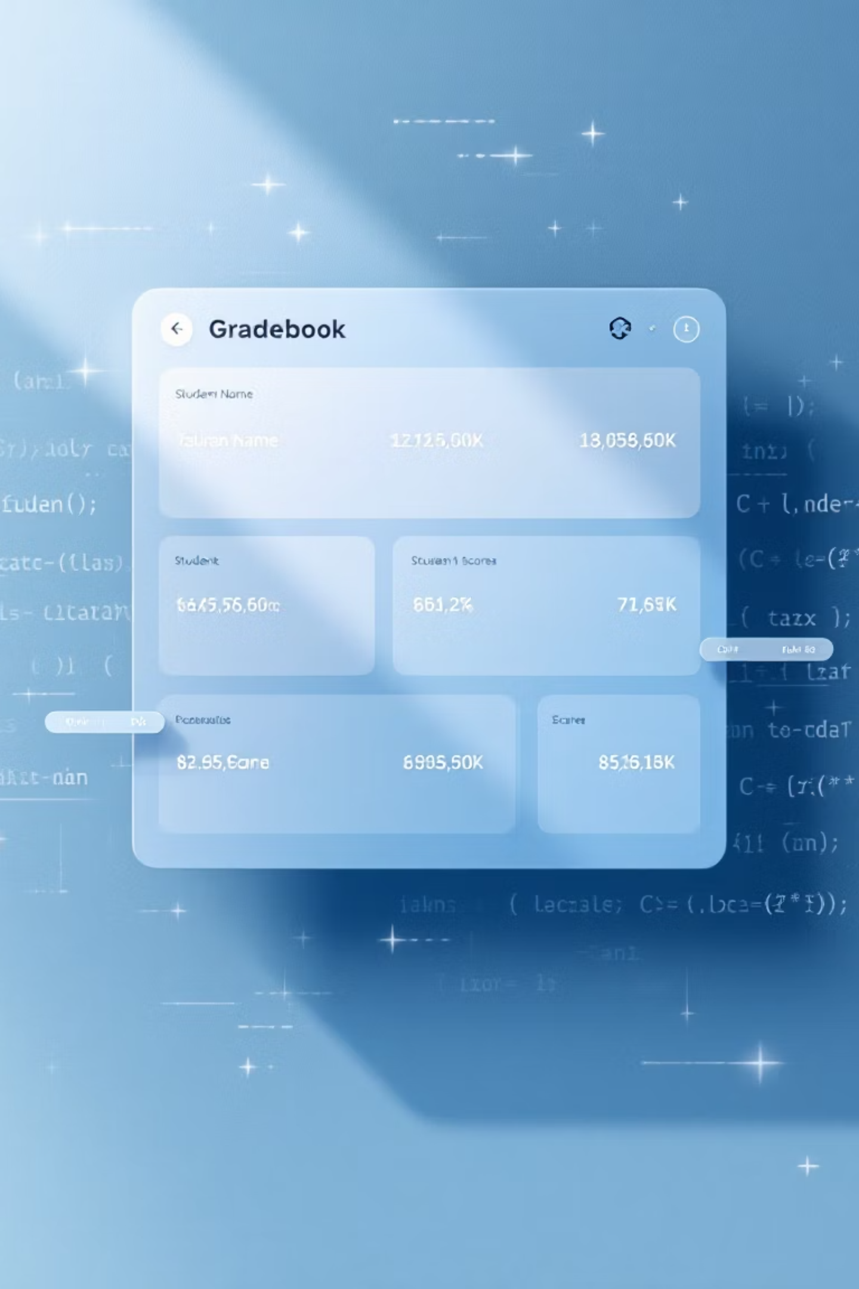
Introduction
The Gradebook with Class Statistics project is a simple C-based program designed to manage students' marks and analyze academic performance.
It helps in calculating:
Average marks
Top score
Grade distribution
This project demonstrates the practical use of loops, conditional statements, and basic logic in C programming.

Slide 4

Problem Statement
The Challenge: Manual Calculations
Our Solution: An Automated C Program
Manually calculating class statistics such as average marks, highest marks, and grade distribution is time-consuming and error-prone.
Develop a C program that:
Takes marks of multiple students
Automatically assigns grades
Generates class statistics efficiently
Works without using arrays (memory efficient)

Slide 5
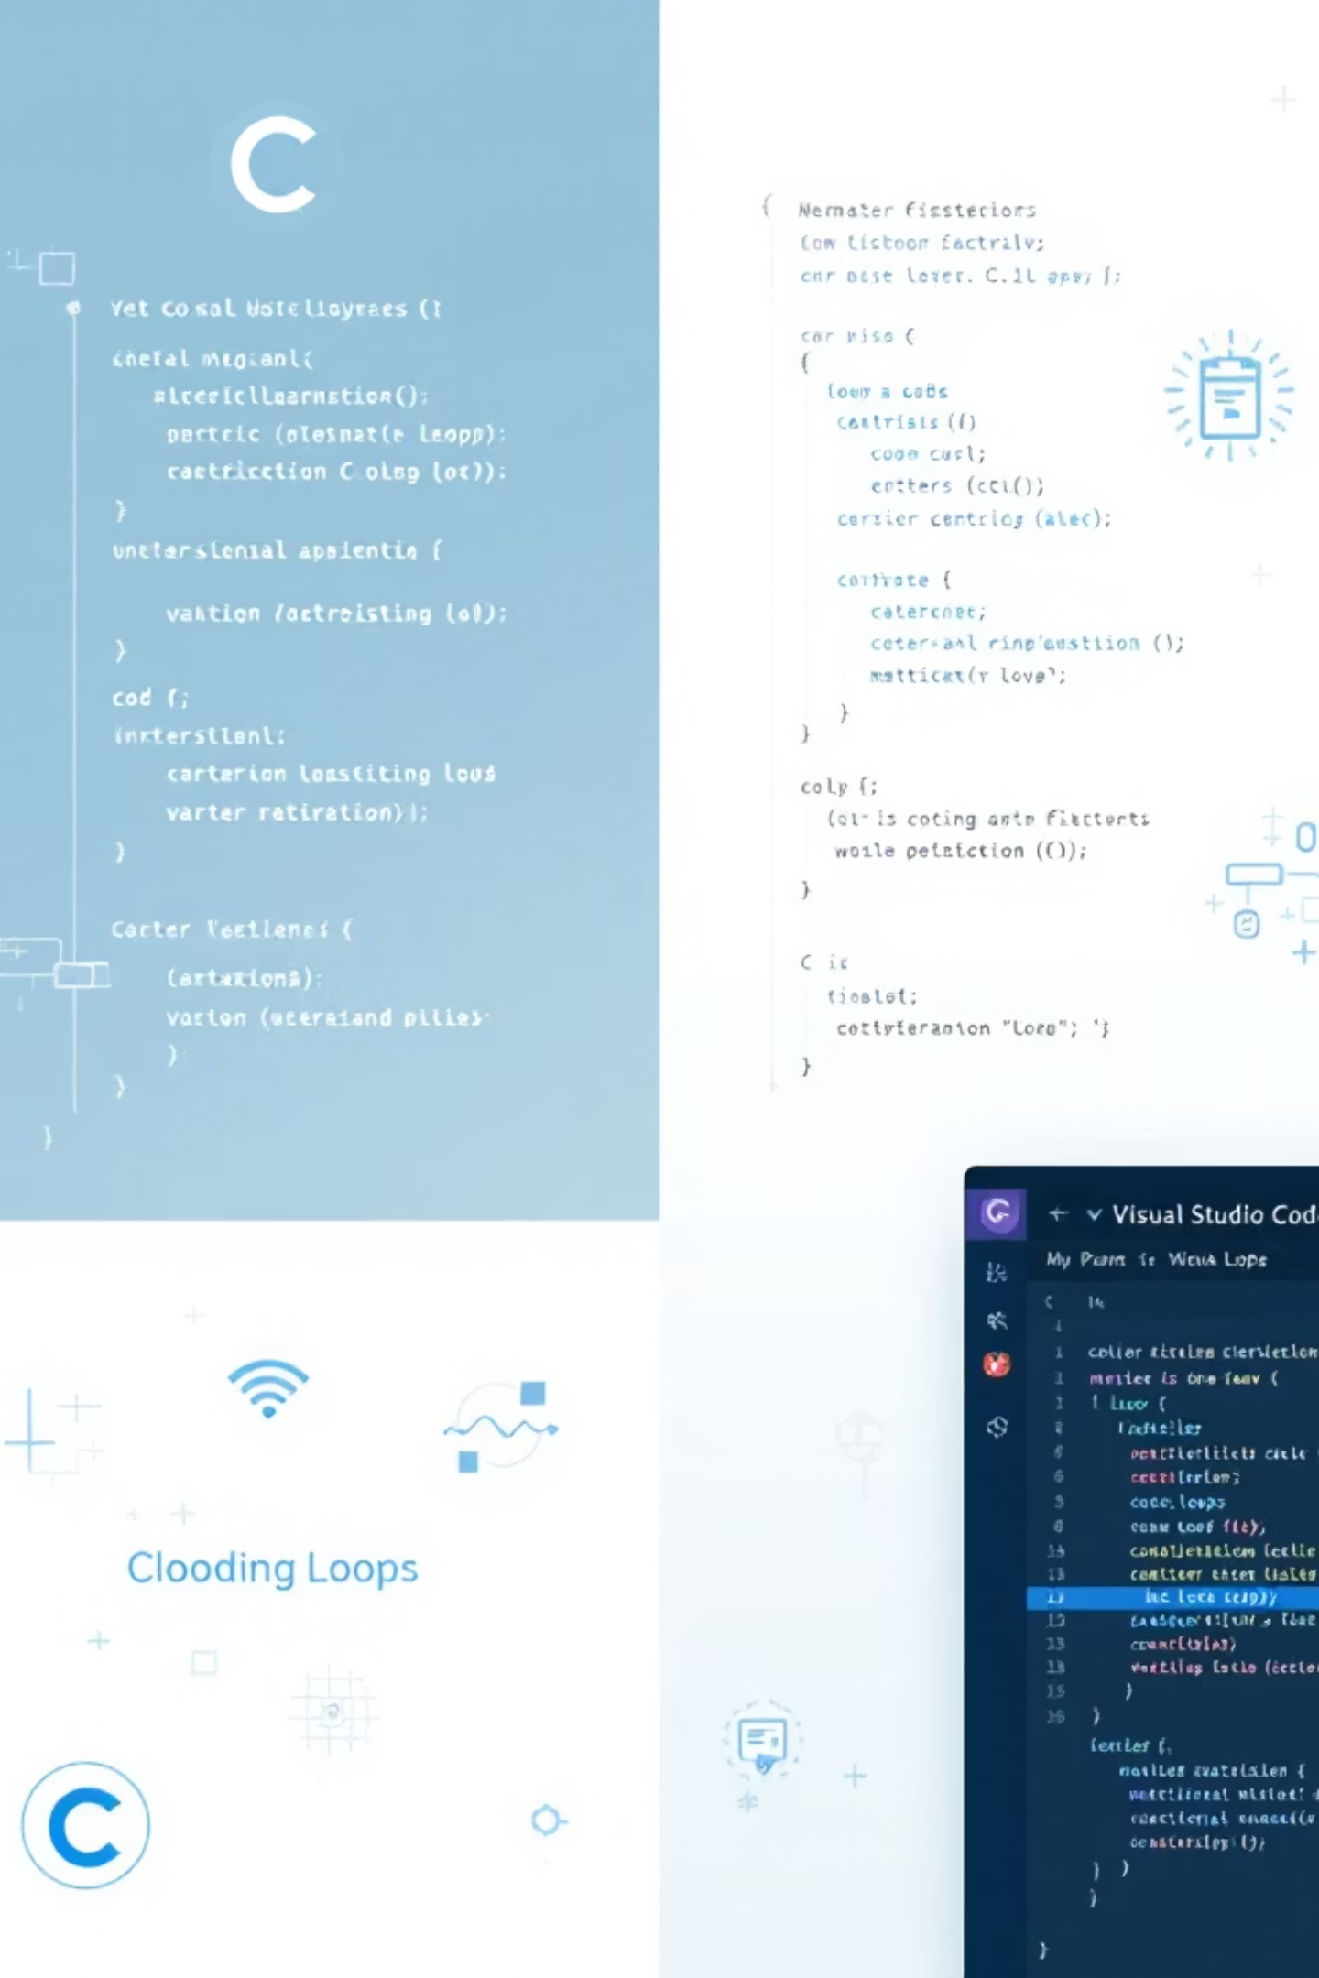
Tools and Technologies
Programming Language:
Concepts Used:
C
Loops
IDE:
Conditional Statements
Variables
Visual Studio Code (VS Code)
Basic Arithmetic Operations
Platform:
Windows

Slide 6
Project Description
The program accepts the number of students and their marks one by one.
It processes data without using arrays and calculates:
Total and average marks
Highest marks in the class
Number of students in each grade (A, B, C, D, F)
Grades are assigned based on predefined mark ranges.

Slide 7
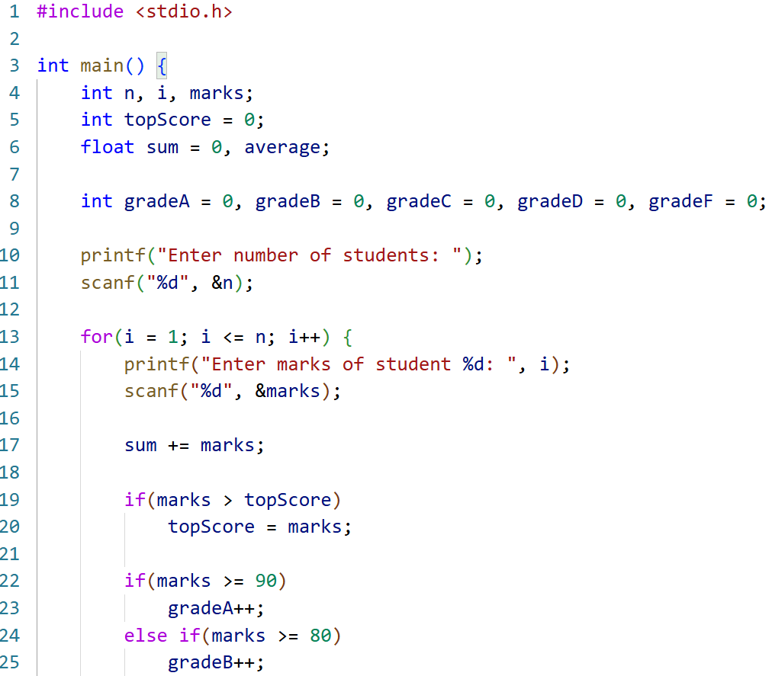
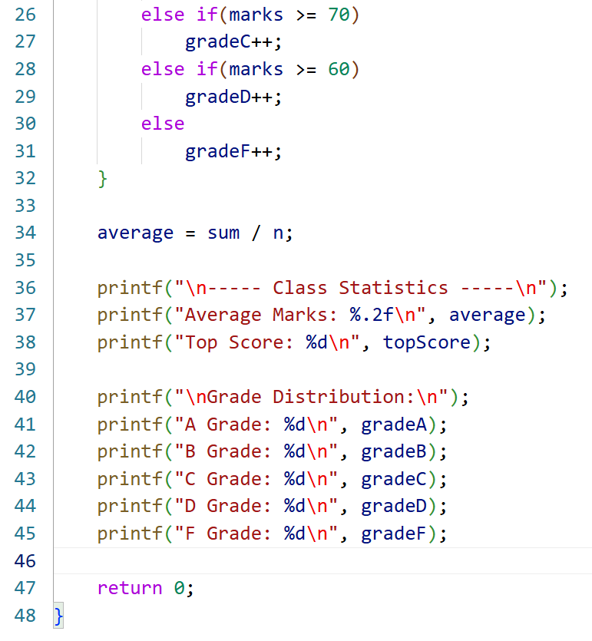

Slide 8
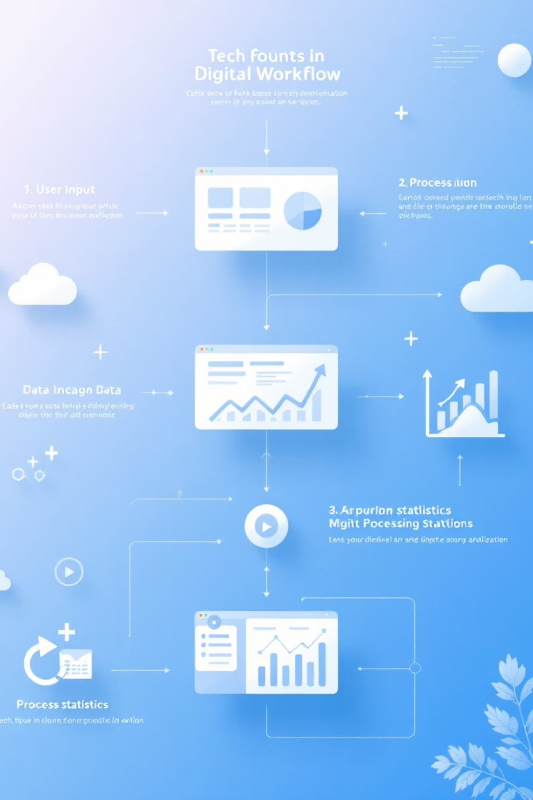


Project Working
User enters number of students
Marks are entered one by one
Program:
Adds marks to total
Finds top score
Counts grades
Final class statistics are displayed

Slide 9


Applications
Schools and Colleges
Teacher's mark evaluation
Academic performance analysis
Learning project for C programming beginners
Small-scale examination systems

Slide 10

Advantages
1
2
Simple and easy to use
No array used (low memory consumption)
3
4
Fast and accurate calculations
Beginner-friendly logic
5
Can be extended for advanced features

Slide 11
Future Scope & Conclusion
FUTURE SCOPE:
CONCLUSION:
Add student names and roll numbers
This project successfully demonstrates how C programming can be used to analyze academic data efficiently. It strengthens core programming concepts and provides a foundation for advanced applications.
Store data using files
Convert to menu-driven program
Graphical grade distribution
Web or GUI-based version

